Slide 1
Big Mountain Resort Pricing Model
December 23, 2022

Slide 2
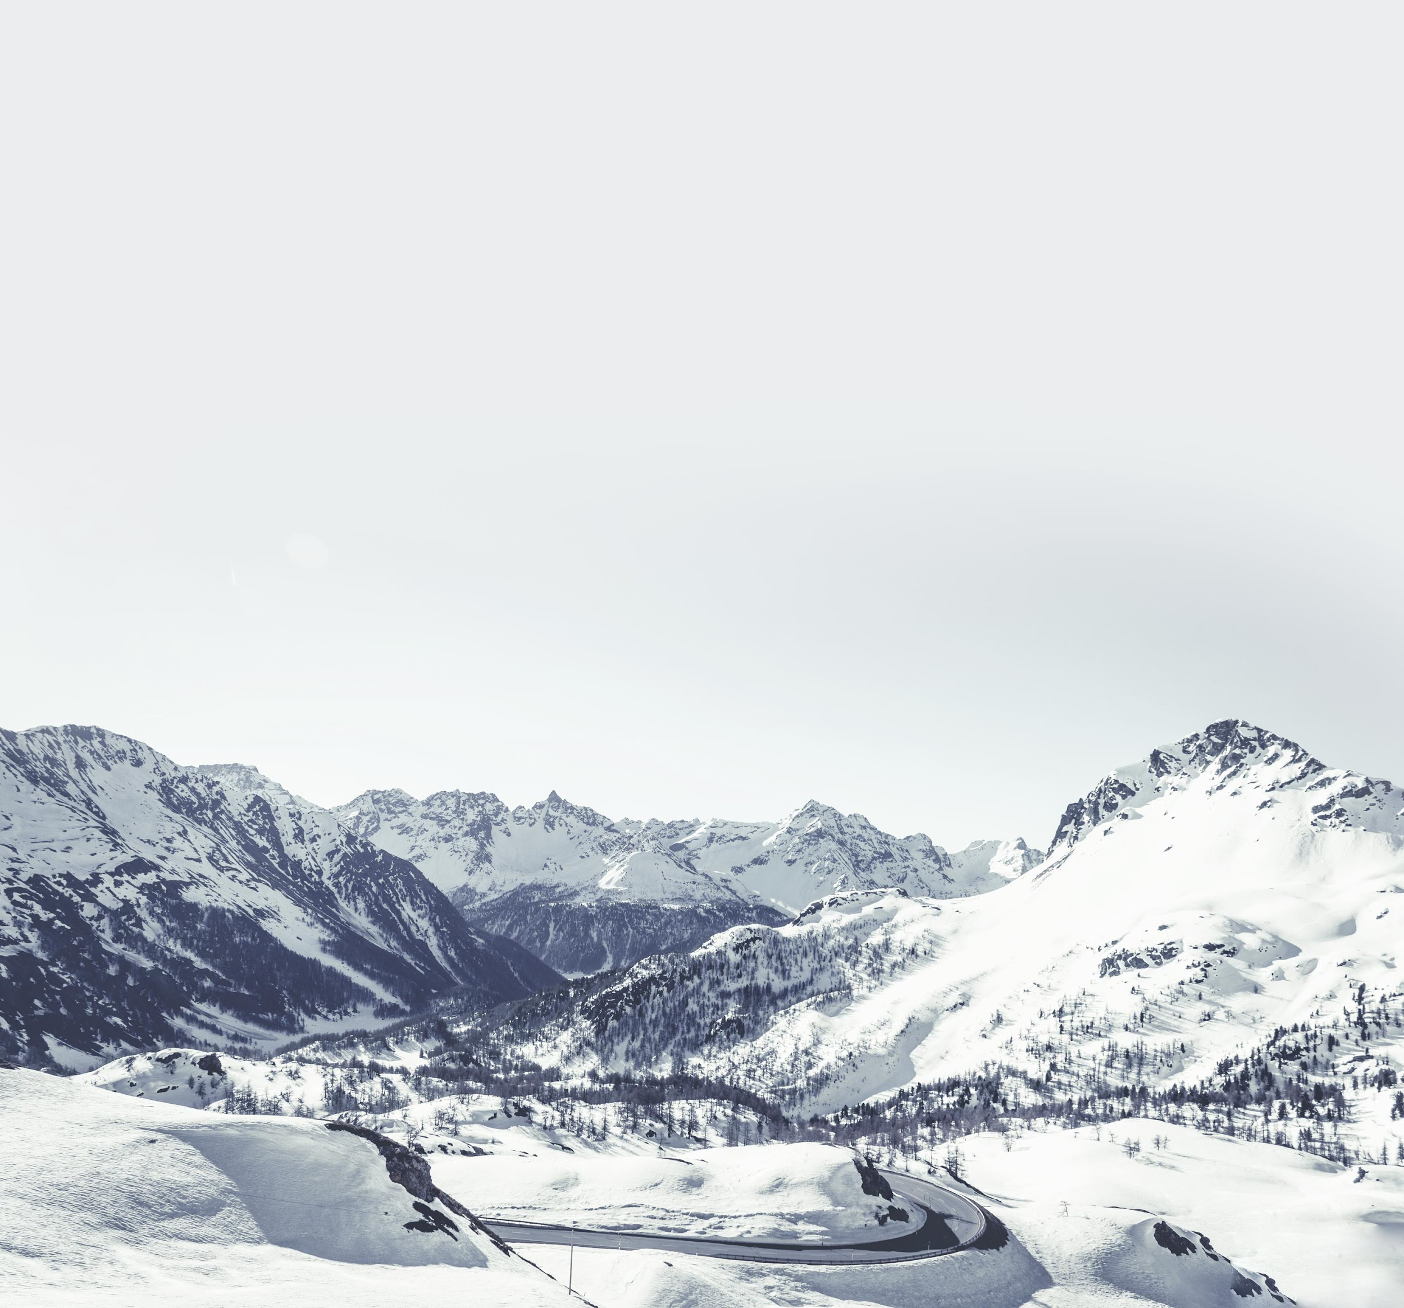
Problem Statement
Can we create and implement a pricing strategy prior to next ski season that accurately reflects the value of our facilities and services?

Slide 3
Project Background
105 trails & 350,000 annual visitors
New lift with an annual operating cost of $1.54M.
Scope:
Use market data to recommend pricing, make model flexible to run pricing scenarios.
1
3
2
Current pricing model is a premium above market - $81/day.
4
Data:
Table of resorts with features to compare.
No visitor numbers for other resorts.

Slide 4
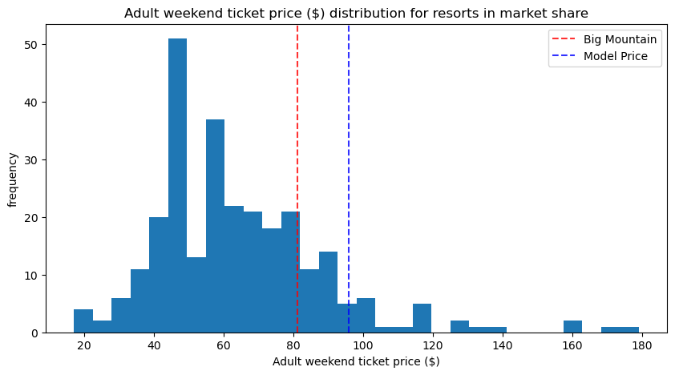
Recommendation
Current Price - $81.00
Suggested Price - $95.87
Statistics:
Mean absolute error: $10.39
Standard Deviation: $1.47
Most Important Features:
Vertical Drop
Snow Making Acres
# of Total Chairs
# of Fast Quad Chairs

Slide 5
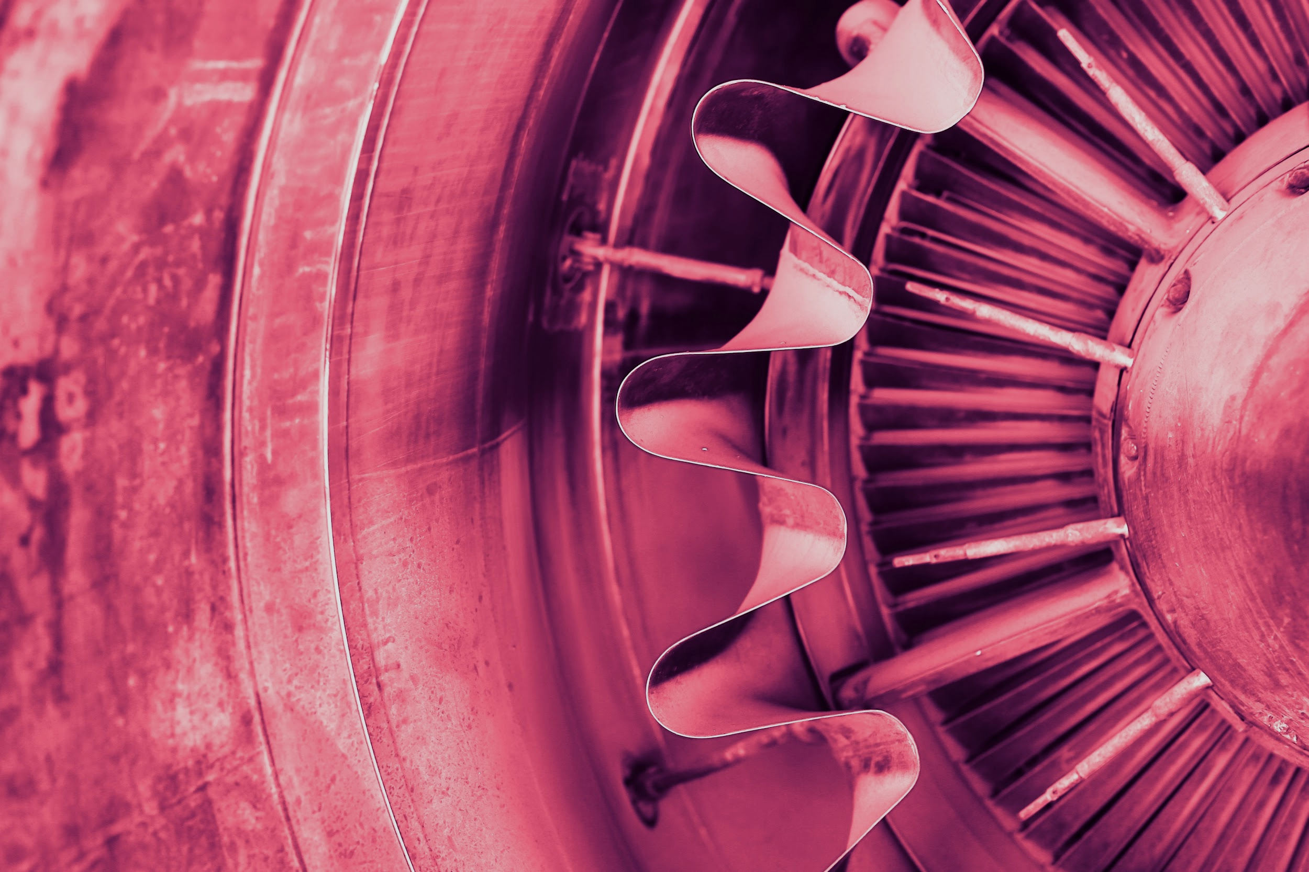
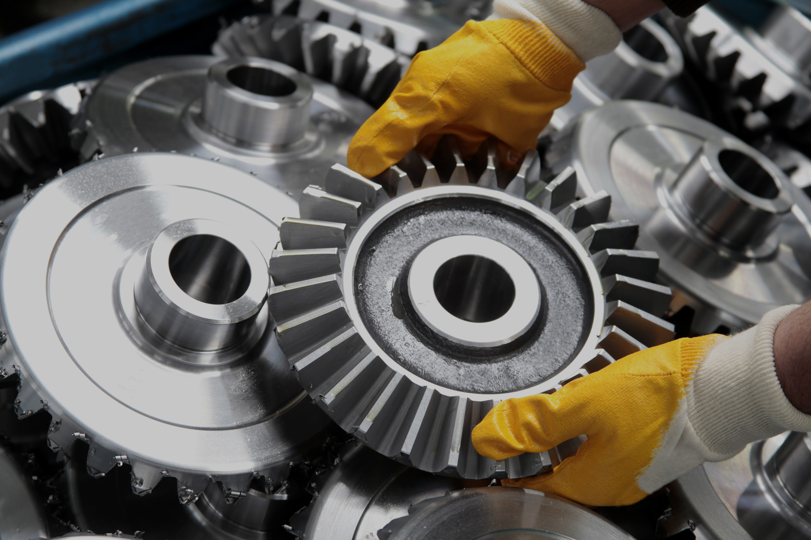
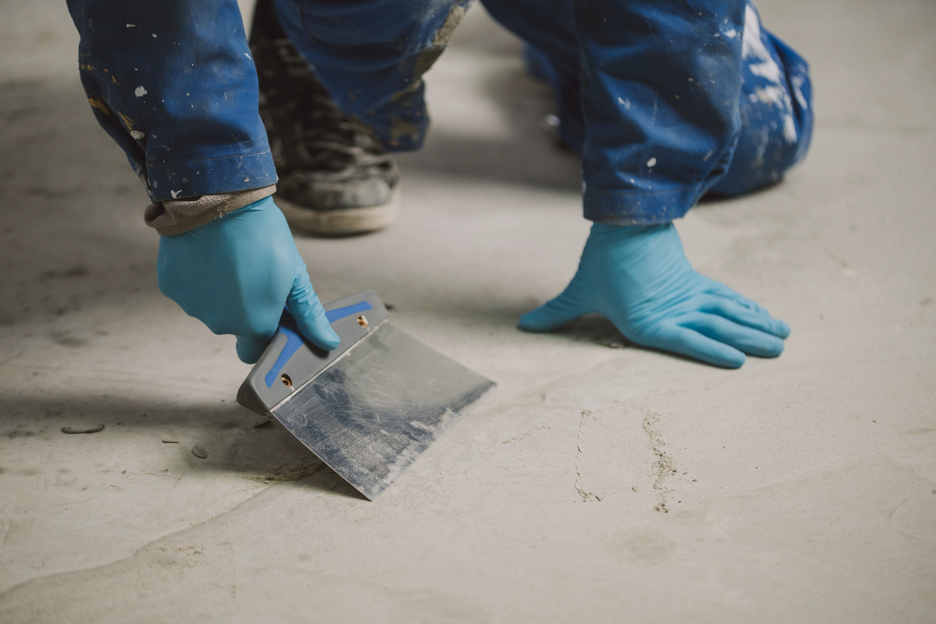
Process
Exploratory Analysis
Data Wrangling
Pre-Processing & Training
01
03
Explored the features with principal component and correlation analysis, settling on Weekend Price as the target feature.
02
Supplemented primary data source with calculated features and added state population and size.
Data split 70% training, 30% testing. Best results from random forest regression.

Slide 6
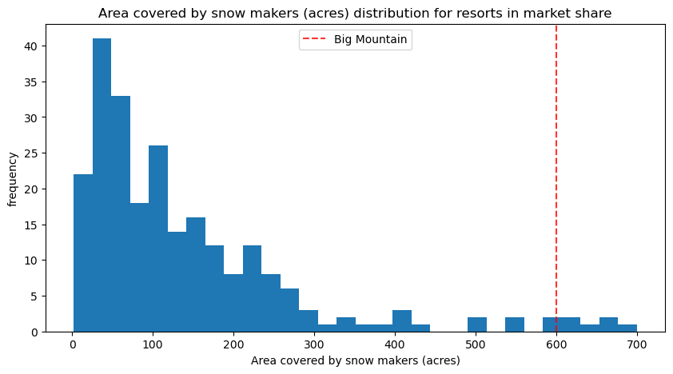
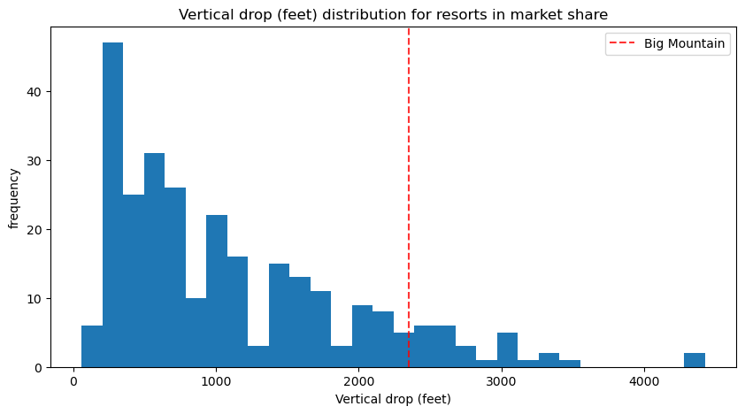
The Model
Trained using data from 276 competitors.
Big Mountain surpasses the market on the most important features.

Slide 7
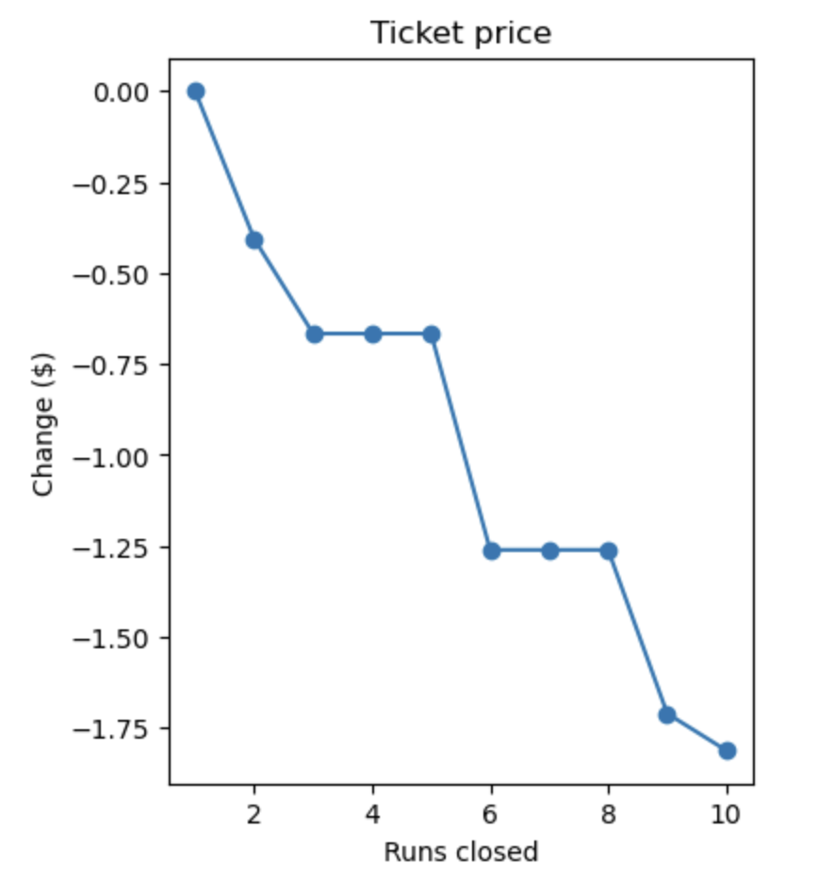
Scenario 01
Permanently close up to 10 of the least used runs, impacting no other statistics.
Modeled Impact of Closing Runs:
1 Run = $0
2 Runs = -$0.41
3-5 Runs = -$0.66
6-8 Runs = -$1.26
9 Runs = -$1.71
10 Runs = -$1.81

Slide 8
Scenario 02
Increase the vertical drop by adding a run to a point 150 feet lower down.
Requires an additional ski lift. No additional snow making.
Modeled Price Impact
Additional Revenue
+$1.99
$3,474,638
From additional features.
Assuming 350k visits,
5 tickets per visitor

Slide 9
Conclusion
With excellent features on which to capitalize, Big Mountain Resort has a prime opportunity to improve their pricing strategy and put them in a position to grow in the future.

Slide 10
Thank you.

